Slide 1
Data Analysis Basics:
Variables and Distribution

Slide 2
Goals
Describe the steps of descriptive data analysis
Be able to define variables
Understand basic coding principles
Learn simple univariate data analysis
Notes:
Unlike the depiction of epidemiologists in some television shows, after gathering data you don’t simply have a brilliant flash of insight and solve the outbreak; you actually have to sit down and analyze that data! It is not the most glamorous part of the epidemiologist’s job, but when the data lead to the source of an outbreak, the analysis is definitely rewarding. This issue of FOCUS will take you through the basic steps of descriptive data analysis, including types of variables, basic coding principles and simple univariate data analysis.

Slide 3
Types of Variables
Continuous variables:
  Always numeric
  Can be any number, positive or negative
  Examples: age in years, weight, blood pressure readings, temperature, concentrations of pollutants and other measurements
Categorical variables:
  Information that can be sorted into categories
  Types of categorical variables – ordinal, nominal and dichotomous (binary)
Notes:
Before delving into analysis, let’s take a moment to discuss variables. This may seem a trivial topic to those with analysis experience, but variables are not a trivial matter. Much like people, variables come in many different sizes and shapes. Most field epidemiology, however, relies on garden-variety continuous and categorical variables.
Continuous variables are always numeric and theoretically can be any number, positive or negative (in reality, this depends upon the variable). Examples of continuous variables are age in years, weight, blood pressure readings, indoor and outdoor temperature, concentrations of pollutants in the air or water, and other measurements.
Categorical variables contain information that can be sorted into categories, rather like sorting information into bins. Every piece of information belongs in one—and only one—bin. There are several types of categorical variables: ordinal, nominal, and dichotomous or binary.

Slide 4
Categorical Variables:
Ordinal Variables
Ordinal variable—a categorical variable with some intrinsic order or numeric value
Examples of ordinal variables:
  Education (no high school degree, HS degree, some college, college degree)
  Agreement (strongly disagree, disagree, neutral, agree, strongly agree)
  Rating (excellent, good, fair, poor)
  Frequency (always, often, sometimes, never)
  Any other scale (“On a scale of 1 to 5...”)
Notes:
An ordinal variable is any categorical variable with some intrinsic order or numeric value. For example, we might categorize information on the educational status of a group of people into a variable called EDUCATION. One person may not have graduated from high school, another might have graduated from high school but received no further education, a third could have some college education or have received some other post-secondary training, and another might have graduated from college. The education levels of all members of the group will fit neatly into these categories, and the categories have an intrinsic order. A college graduate has more education than a high school graduate, and a high school graduate has more education than someone who did not graduate from high school. Thus as the categories go from 1 to 5, the level of education increases. Other examples of ordinal variables are:
agreement (for example, strongly disagree, disagree, neutral, agree, strongly agree)
rating (for example, excellent, good, fair, poor)
frequency (for example, always, often, sometimes, never)
or any other scale (for example, “On a scale of 1 to 5, how much do you like peanuts?”)

Slide 5
Categorical Variables:
Nominal Variables
Nominal variable – a categorical variable without an intrinsic order
Examples of nominal variables:
  Where a person lives in the U.S. (Northeast, South, Midwest, etc.)
  Sex (male, female)
  Nationality (American, Mexican, French)
  Race/ethnicity (African American, Hispanic, White, Asian American)
  Favorite pet (dog, cat, fish, snake)
Notes:
A nominal variable is a categorical variable without any intrinsic order. For example, say we have a variable called RESIDE that characterizes the part of the United States in which a person lives—the Northeast, the South, the Midwest, the Southwest, or the Northwest. The categories of this variable have no numeric value or order. Residence in the Northwest has no quantitative value compared to the Northeast. Other examples of nominal variables include sex (male, female), nationality (American, Mexican, French), race/ethnicity (African American, Hispanic, White, Asian American), or favorite pet (dog, cat, fish, snake).

Slide 6
Categorical Variables:
Dichotomous Variables
Dichotomous (or binary) variables – a categorical variable with only 2 levels of categories
  Often represents the answer to a yes or no question
For example:
  “Did you attend the church picnic on May 24?”
  “Did you eat potato salad at the picnic?”
  Anything with only 2 categories
Notes:
A dichotomous, or binary variable is a categorical variable that has only 2 levels or categories. Many dichotomous variables represent the answer to a yes or no question. For example, “Did you attend the church picnic on May 24?” or “Did you eat potato salad at the picnic?” A variable does not have to be a yes/no variable to be dichotomous–it just has to have only 2 categories, such as sex (male/female).

Slide 7
Coding
Coding – process of translating information gathered from questionnaires or other sources into something that can be analyzed
Involves assigning a value to the information given—often value is given a label
Coding can make data more consistent:
  Example: Question = Sex
  Answers = Male, Female, M, or F
  Coding will avoid such inconsistencies
Notes:
Once you have gathered your questionnaire or other data, you may choose to code the data for entry into a database. Coding is the process of translating the information gathered from questionnaires or other investigations into something that can be analyzed, usually using a computer program. Coding involves assigning a value to the information given in a questionnaire, and often that value is given a label. In addition, coding can make the data more consistent. For example, if you have the question “Sex?” you might end up with the answers “Male”, “Female”, or “M”, “F”, etc. Coding will avoid such inconsistencies.

Slide 8
Coding Systems
Common coding systems (code and label) for dichotomous variables:
  0=No 1=Yes
  (1 = value assigned, Yes= label of value)
  OR: 1=No 2=Yes
When you assign a value you must also make it clear what that value means
  In first example above, 1=Yes but in second example 1=No
  As long as it is clear how the data are coded, either is fine
You can make it clear by creating a data dictionary to accompany the dataset
Notes:
A common coding system (code and label) for dichotomous variables is the following:
0 = No 1 = Yes,
where the number 1 is the value assigned, and Yes is the label or meaning of that value.
Some like to use a system of ones and twos, where
1 = No 2 = Yes.
This brings out an important point in coding. When you assign a value to a piece of information, you must also make it clear what that value means. In the first example given above, 1 = Yes, but in the second example, 1 = No. Either way is fine, as long as it is clear how the data are coded. You can make it clear by creating a data dictionary as a separate file to accompany the dataset.

Slide 9
Coding: Dummy Variables
A “dummy” variable is any variable that is coded to have 2 levels (yes/no, male/female, etc.)
Dummy variables may be used to represent more complicated variables
  Example: # of cigarettes smoked per week--answers total 75 different responses ranging from 0 cigarettes to 3 packs per week
  Can be recoded as a dummy variable:
  1=smokes (at all) 0=non-smoker
This type of coding is useful in later stages of analysis
Notes:
Dichotomous variables can also be dummy variables. A “dummy” variable is any variable that is coded to have 2 levels, like the yes/no variables and male/female variables above. They can also be used to represent or stand in for more complicated variables. This is especially useful when you have many values that are more meaningful when analyzed in terms of a yes/no response.
For example, you may have collected data on the number of cigarettes smoked per week, with 75 different responses ranging from no cigarettes at all to 3 packs a week, but you can recode these data as a dummy variable: 1 = Smokes (at all), 0 = Non-smoker. You could also do this for education (1 = Any post-high school education, 0 = No post-high school education), food consumption (1 = Ate item at all during time period, 0 = Did not eat the item), and many other variables. This type of coding is useful in the later stages of analysis.

Slide 10
Coding:
Attaching Labels to Values
Many analysis software packages allow you to attach a label to the variable values
  Example: Label 0’s as male and 1’s as female
Makes reading data output easier:
  Without label: Variable SEX Frequency Percent
  0 21 60%
  1 14 40%
  With label: Variable SEX Frequency Percent
  Male 21 60%
  Female 14 40%
Notes:
Many analysis software packages allow you to attach a label to variable values. Then the computer automatically labels the 0’s as male and the 1’s as female, which makes your life much easier when you are looking at the output, as shown in the example below:
Without label: Variable SEX Frequency Percent
0 21 60%
1 14 40%
With label: Variable SEX Frequency Percent
Male 21 60%
Female 14 40%

Slide 11
Coding- Ordinal Variables
Coding process is similar with other categorical variables
Example: variable EDUCATION, possible coding:
  0 = Did not graduate from high school
  1 = High school graduate
  2 = Some college or post-high school education
  3 = College graduate
Could be coded in reverse order (0=college graduate, 3=did not graduate high school)
For this ordinal categorical variable we want to be consistent with numbering because the value of the code assigned has significance
Notes:
The coding process is similar with other categorical variables. For the variable EDUCATION mentioned above, we might code as follows:
0 = Did not graduate from high school
1 = High school graduate
2 = Some college or post-high school education
3 = College graduate.
Note that for this ordinal categorical variable, we need to be consistent with the numbering, because the value of the code assigned has significance. The higher the code, the more educated the respondent is. We could have also coded this variable in reverse order, so that 0 = College graduate, and 3 = Did not graduate from high school. In this case, the higher the code, the less educated the respondent is. Either way is fine, as long as we remember the coding when interpreting the analysis.

Slide 12
Coding – Ordinal Variables (cont.)
Example of bad coding:
  0 = Some college or post-high school education
  1 = High school graduate
  2 = College graduate
  3 = Did not graduate from high school
Data has an inherent order but coding does not follow that order—NOT appropriate coding for an ordinal categorical variable
Notes:
The following is an example of bad coding:
0 = Some college or post-high school education
1 = High school graduate
2 = College graduate
3 = Did not graduate from high school
The data we are trying to code has an inherent order, but the coding in this example does not follow that order. This is not appropriate coding for an ordinal categorical variable.

Slide 13
Coding: Nominal Variables
For coding nominal variables, order makes no difference
Example: variable RESIDE
  1 = Northeast
  2 = South
  3 = Northwest
  4 = Midwest
  5 = Southwest
Order does not matter, no ordered value associated with each response
Notes:
For a nominal categorical variable, however, the order makes no difference. Although we code each category with a number, the number does not represent a numerical value. For example, using the variable RESIDE mentioned earlier,
1 = Northeast
2 = South
3 = Northwest
4 = Midwest
5 = Southwest.
It doesn’t matter what order we use for these categories. Midwest can be coded as 4, 2 or 5, because there is not an ordered value associated with each response.

Slide 14
Coding: Continuous Variables
Creating categories from a continuous variable (ex. age) is common
May break down a continuous variable into chosen categories by creating an ordinal categorical variable
Example: variable = AGECAT
  1 = 0–9 years old
  2 = 10–19 years old
  3 = 20–39 years old
  4 = 40–59 years old
  5 = 60 years or older
Notes:
Coding continuous variables is straightforward. If someone gives his or her age as 37 years, you enter it into the database as 37. But what if you decided that you would rather use age categories instead of the data you collected in years?
Creating categories from a continuous variable is common, and can easily be done using analysis software. With a software package, you can break down a continuous variable such as age into categories by creating an ordinal categorical variable, such as the following:
AGECAT
1 = 0–9 years old
2 = 10–19 years old
3 = 20–39 years old
4 = 40–59 years old
5 = 60 years or older.

Slide 15
Coding:
Continuous Variables (cont.)
May need to code responses from fill-in-the-blank and open-ended questions
  Example: “Why did you choose not to see a doctor about this illness?”
One approach is to group together responses with similar themes
  Example: “didn’t feel sick enough to see a doctor”, “symptoms stopped,” and “illness didn’t last very long”
  Could all be grouped together as “illness was not severe”
Also need to code for “don’t know” responses”
  Typically, “don’t know” is coded as 9
Notes:
You may also need to code responses from fill-in-the-blank and open-ended questions. With an open-ended question such as “Why did you choose not to see a doctor about this illness?”, respondents will all answer somewhat differently. Also, you may give response choices for a particular question but offer an “other (specify)” option as well, where respondents can write whatever response they choose. These types of open-ended questions can be a lot of work to analyze. One way to analyze the information is to group together responses with similar themes. For the question above, responses of “didn’t feel sick enough to see a doctor,” “symptoms stopped,” and “the illness didn’t last very long,” could all be grouped together as “the illness was not severe.”
You will also need to code “don’t know” responses. Typically, “don’t know” is coded as 9.

Slide 16
Coding Tip
Though you do not code until the data is gathered, you should think about how you are going to code while designing your questionnaire, before you gather any data. This will help you to collect the data in a format you can use.
Notes:
Coding Tip:
Though you do not code until the data is gathered, you should think about how you are going to code while designing your questionnaire, before you gather any data. This will help you to collect the data in a format you can use.

Slide 17
Data Cleaning
One of the first steps in analyzing data is to “clean” it of any obvious data entry errors:
  Outliers? (really high or low numbers)
  Example: Age = 110 (really 10 or 11?)
  Value entered that doesn’t exist for variable?
  Example: 2 entered where 1=male, 0=female
  Missing values?
  Did the person not give an answer? Was answer accidentally not entered into the database?
Notes:
Data Cleaning
One of the first steps in analyzing data is to look at the data and “clean” it of any obvious errors due to incorrect data entry.
If there are outliers (really high or really low numbers), are those numbers correct? An age value of 110 years could be an error for someone who was really 10 or 11 (or 101!).
Was a value entered that doesn’t exist for the variable? For example, if 1 = male and 0 = female, and the number “2” was entered, there is clearly an error.
If there are missing values, did the person not give an answer, or was it accidentally not entered into the database?

Slide 18
Data Cleaning (cont.)
May be able to set defined limits when entering data
  Prevents entering a 2 when only 1, 0, or missing are acceptable values
Limits can be set for continuous and nominal variables
  Examples: Only allowing 3 digits for age, limiting words that can be entered, assigning field types (e.g. formatting dates as mm/dd/yyyy or specifying numeric values or text)
Many data entry systems allow “double-entry” – ie., entering the data twice and then comparing both entries for discrepancies
Univariate data analysis is a useful way to check the quality of the data
Notes:
Some software programs allow the user to set defined limits when entering data. That prevents a person from entering a 2 when only 1, 0, or missing are acceptable values. Limits can also be set for continuous and nominal variables, for example allowing only up to 3 digits for age, or limiting the words that can be entered. You can also assign field types for most kinds of variables based on what type of data the field should contain (e.g., formatting dates as mm/dd/yyyy or specifying numeric values or text). Also, some study protocols allow missing data to be entered from other sources. For example, if a person did not answer the question about age, that information could be available from a medical record being used in the study.
As a check on data entry, many data entry systems allow you to enter all of the data twice, and then compare the two entries to see if there are discrepancies. This process is called “double-entry.”
Univariate data analysis, which we discuss next, is also a useful way to check the quality of the data, including checking for outliers.

Slide 19
Univariate Data Analysis
Univariate data analysis-explores each variable in a data set separately
  Serves as a good method to check the quality of the data
  Inconsistencies or unexpected results should be investigated using the original data as the reference point
Frequencies can tell you if many study participants share a characteristic of interest (age, gender, etc.)
  Graphs and tables can be helpful
Notes:
Univariate Data Analysis
Univariate data analysis is important for many reasons. Looking at each variable alone, we learn a lot about the information collected. Also, univariate analysis is a good method of checking the quality of the data. Inconsistencies or unexpected results should always be investigated, using the original data as the reference point.
Simple frequencies can tell you whether most cases are young, or whether most cases are female, or whether many study participants share some other characteristic in which you are interested. First, examine the univariate (one variable) distribution. Graphs and tables can give you a good idea of what your variables look like, and can also help you find some of the data cleaning problems noted above.

Slide 20
Univariate Data Analysis (cont.)
Examining continuous variables can give you important information:
  Do all subjects have data, or are values missing?
  Are most values clumped together, or is there a lot of variation?
  Are there outliers?
  Do the minimum and maximum values make sense, or could there be mistakes in the coding?
Notes:
Continuous Variables
An initial look at continuous variables can give you several important pieces of information:
Do all subjects have data, or are values missing?
Are most values clumped together, or is there a lot of variation? (Figures 1a and 1b)
Are there outliers?
Do the minimum and maximum values make sense, or could there be mistakes in the coding?

Slide 21
Univariate Data Analysis (cont.)
Commonly used statistics with univariate analysis of continuous variables:
  Mean – average of all values of this variable in the dataset
  Median – the middle of the distribution, the number where half of the values are above and half are below
  Mode – the value that occurs the most times
  Range of values – from minimum value to maximum value
Notes:
We can also conduct a univariate analysis of continuous variables to gain valuable information. Commonly used statistics include these:
Mean – average of all values of this variable in the dataset.
Median – the middle of the distribution, the number where half of the values are above and half are below.
Mode – the value that occurs most.
Range of values – from minimum value to maximum value.

Slide 22
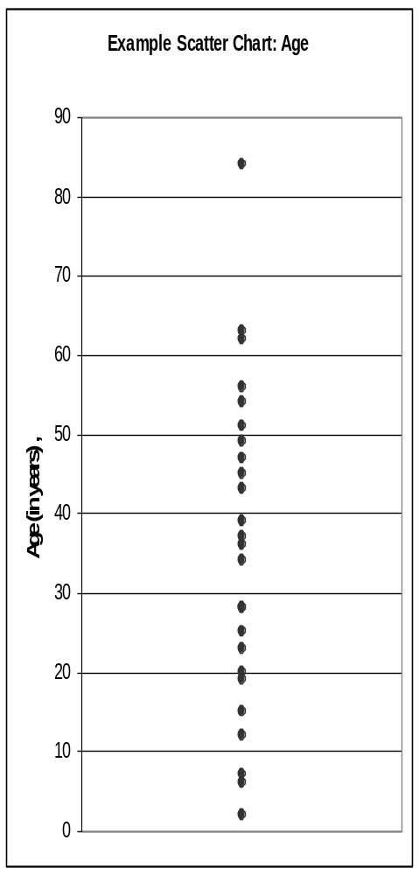
Statistics describing a continuous variable distribution
84 = Maximum (an outlier)
36 = Median (50th Percentile)
33 = Mean
28 = Mode (Occurs twice)
2 = Minimum
Notes:
This figure demonstrates some of the statistics mentioned on the previous slide such as mean, median, mode and range of values.

Slide 23
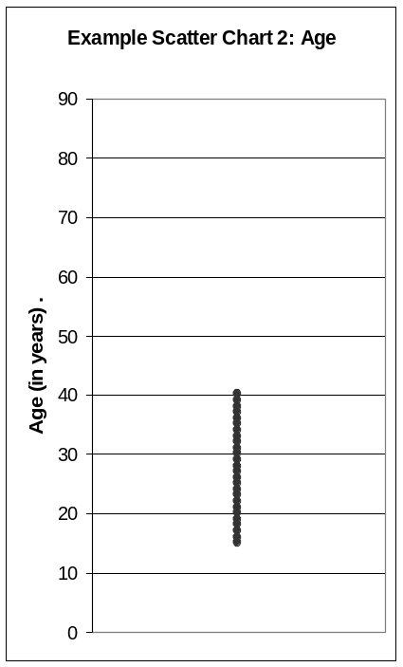
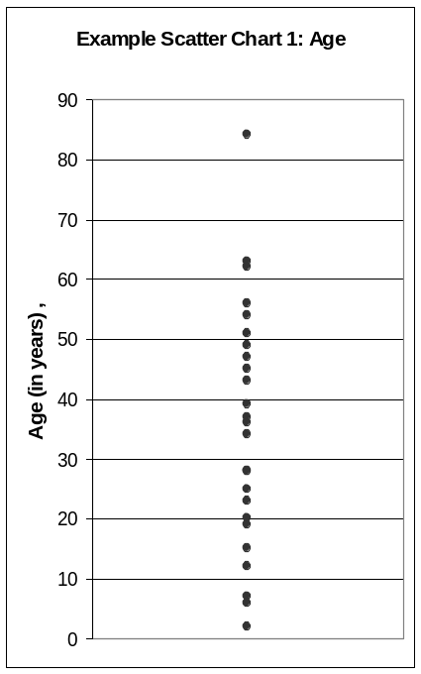
Standard Deviation
Figure left: narrowly distributed age values (SD = 7.6)
Figure right: widely distributed age values (SD = 20.4)
Notes:
Another statistic used is standard deviation
Standard deviation is a measure of how variable the data are. In the figure on the right, the standard deviation is 20.4; in the figure on the left, it is 7.6. A large standard deviation compared to the values of the variable indicates that the data are widely distributed. Standard deviations can be calculated most easily with a software program, although they can be calculated by hand.

Slide 24
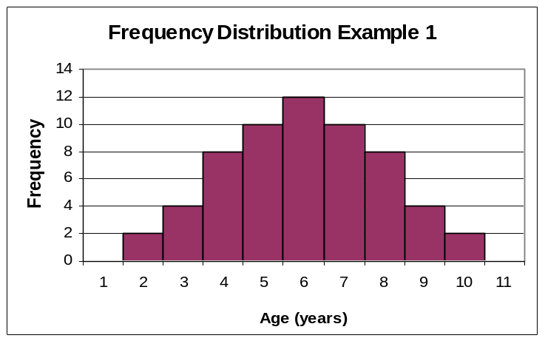
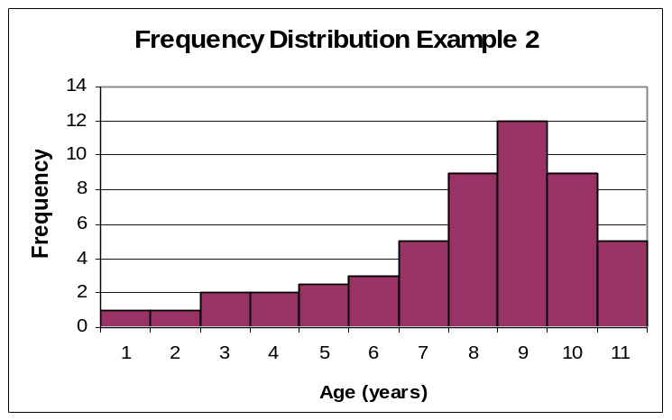
Distribution and Percentiles
  Distribution – whether most values occur low in the range, high in the range, or grouped in the middle
  Percentiles – the percent of the distribution that is equal to or below a certain value
Distribution curves for variable AGE
25th Percentile
(4 years)
25th Percentile
(6 years)
Notes:
Additional statistics include:
Distribution – shows whether most values occur low in the range, high in the range, or grouped in the middle.
Percentiles – the percent of the distribution that is equal to or below a certain value. In the top figure the 25th percentile occurs at 4 years because 25% of the total number of respondents are 4 years or younger while in the bottom figure the 25th percentile occurs at 6 years. The top figure is a “bell-shaped” distribution while the bottom figure is a skewed distribution.

Slide 25
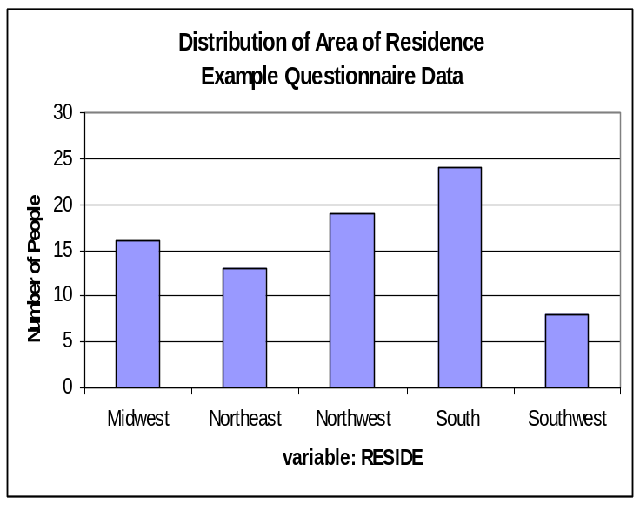
Analysis of Categorical Data
Distribution of categorical variables should be examined before more in-depth analyses
  Example: variable RESIDE
Number of people answering example questionnaire who reside in 5 regions of the United States
Notes:
The distribution of categorical variables should also be examined before undertaking more in-depth analyses.
For example, let’s look at the variable RESIDE, shown in the figure. We see that more people live in the South than elsewhere, while fewer people live in the Southwest than elsewhere. The geographic area of residence may be important in some studies, because lifestyles and cultural influences tend to differ in different parts of the country. One way to put these results in context is to compare this distribution to the “expected” distribution of residence. If we selected our study participants randomly from the US population, we would expect to have the same distribution of people in each region.
In the example above, an epidemiologist would want to compare the observed number of people in each region to the expected number of people in each region. Comparing the observed data with the expected data is a way for epidemiologists to see if there is something out of the ordinary associated with the observed data.

Slide 26
Analysis of Categorical Data (cont.)
Another way to look at the data is to list the data categories in tables
Table shown gives same information as in previous figure but in a different format
Table: Number of people answering sample questionnaire who reside in 5 regions of the United States
Frequency Percent
Midwest 16 20%
Northeast 13 16%
Northwest 19 24%
South 24 30%
Southwest 8 10%
Total 80 100%
Notes:
Another way we can take a look at this categorical data is by listing the data categories in tables. For example, this table gives us the same information as the figure on the previous slide, but in a different format. Many tables display the frequency (number) as well as the percent of the total individuals in the table. When graphs or tables are used to report and describe data, they should include all relevant information in the titles, headers, and labels, such as the study population, dates of the study, and number of participants.

Slide 27
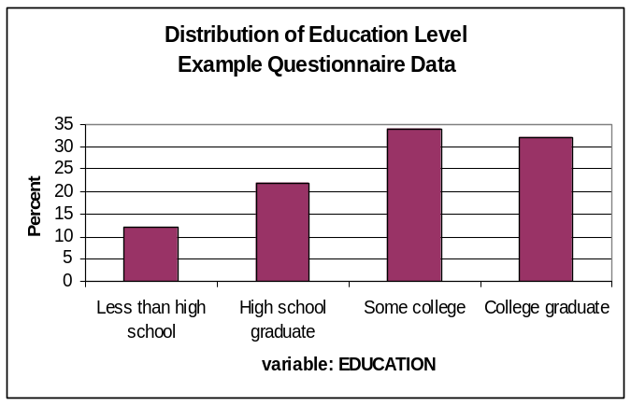
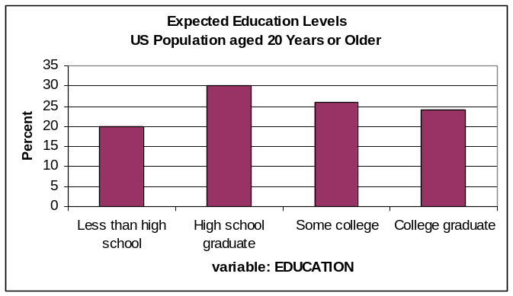
Observed vs. Expected Distribution
Education variable
  Observed distribution of education levels (top)
  Expected distribution of education (bottom) (1)
  Comparing graphs shows a more educated study population than expected
Are the observed data really that different from the expected data?
Answer would require further exploration with statistical tests
Observed data on level of education from a hypothetical questionnaire
Data on the education level of the US population aged 20 years or older, from the US Census Bureau
Notes:
We can go through the process with our ordinal categorical variable EDUCATION. This figure shows the observed distribution of education levels in a given population of adults. Although the graph is labeled with education levels, those labels represent numbers used in coding (0 for less than high school education, 1 for high school graduates, and so on).
This graph contains useful descriptive information about the study population. We can also compare this to the expected distribution of education among our study participants. Information from the US Census Bureau on the educational attainment of the US population aged 20 years or older is shown in the bottom figure. (1) This is the expected distribution of education level for the US population. By looking at the graphs and comparing the categories, we see that our study population appears to be more educated that we would have expected.
Are the observed data really that different from the expected data? This is the type of question an epidemiologist might explore further.

Slide 28
Conclusion
Defining variables and basic coding are basic steps in data analysis
Simple univariate analysis may be used with continuous and categorical variables
Further analysis may require statistical tests such as chi-squares and other more extensive data analysis
Notes:
This discussion has covered basic data analysis and definition of variables. Future issues of FOCUS will discuss chi-squares and other types of more extensive data analysis.

Slide 29
References
1. US Census Bureau. Educational Attainment in the United States: 2003---Detailed Tables for Current Population Report, P20-550 (All Races). Available at: http://www.census.gov/population/www/socdemo/education/cps2003.html. Accessed December 11, 2006.
Notes:
1. US Census Bureau. Educational Attainment in the United States: 2003---Detailed Tables for Current Population Report, P20-550 (All Races). Available at: http://www.census.gov/population/www/socdemo/education/cps2003.html. Accessed December 11, 2006.

